Slide 1

Developing Fit-for-Purpose Resilience Strategies
Resilience Strategic Overview & Frameworks for DRI International Certifications
This course teaches how to design and implement resilience strategies that align with organizational context, maturity, and capability for effective business continuity management.
Aligning resilience strategy with business priorities
Adapting frameworks to fit organizational context

Slide 2
CLASS AGENDA
CLASS OBJECTIVES
Defining fit-for-purpose
Aligning with business context
Tailoring frameworks to maturity
Measuring success and improvement
Explain what makes a strategy "fit-for-purpose"
Identify context-driven decision factors
Apply frameworks effectively across organizations

Slide 3

What Does "Fit-for-Purpose" Mean?
Strategy reflects actual business needs, risks, and capabilities
Avoids unnecessary complexity or minimal coverage
Focused on realistic, actionable outcomes
Balances resource investment with risk exposure

Slide 4

Why Tailored Strategies Matter
Each organization has unique risks, culture, and budget
Generic frameworks often fail in real conditions
Customization builds adoption and accountability
One-size-fits-all approaches create compliance theater

Slide 5

Strategic Alignment with Business Objectives
Integrate resilience into mission and operations
Balance continuity, recovery, and innovation
Ensure executive sponsorship and governance
Connect resilience investments to business value

Slide 6

Foundational Frameworks and Standards
ISO 22301, NIST, and DRI Professional Practices
Adapt, don't copy, external frameworks
Emphasize proportional controls based on maturity
Build from proven methodologies while customizing

Slide 7

Understanding Organizational Context
Identify key dependencies and interconnections
Understand culture, risk appetite, and resource levels
Evaluate resilience enablers and barriers
Map stakeholder expectations and requirements

Slide 8

Assessing Maturity and Capability
Early Stage
Mid Stage
Limited processes, ad hoc responses
Structured processes, defined roles
Mature
Embedded culture, proactive management

Slide 9

Aligning Strategy with Resources
Scale resilience initiatives to available funding
Use cost-benefit prioritization
Focus on critical outcomes, not perfection
Implement phased approaches for budget constraints

Slide 10

Building Collaborative Ownership
Involve HR, IT, communications, and operations
Promote shared accountability
Leadership sponsorship drives continuity success
Create cross-functional resilience committees

Slide 11

Scenario Testing and Validation
Test resilience strategies through exercises
Compare outcomes with recovery objectives
Refine based on real-world lessons
Validate assumptions through realistic scenarios

Slide 12

Continuous Improvement Mindset
Resilience evolves alongside business growth
Incorporate post-incident lessons learned
Review and adjust strategies regularly
Monitor effectiveness through key metrics

Slide 13

Common Pitfalls and Misalignments
Overly complex frameworks
Neglecting culture and communication
Lack of leadership engagement
Focusing on compliance over effectiveness

Slide 14
Real-World Example: Context-Driven Strategy
Startups
Enterprises
Local Governments
Focus on agility and data redundancy
Prioritize compliance and governance
Emphasize people and public service
Cloud-first infrastructure
Structured processes
Community impact focus
Minimal bureaucracy
Regulatory alignment
Multi-agency coordination
Rapid response capability
Board-level oversight
Public communication

Slide 15

Summary and Key Takeaways
Strategy must fit organizational scale, risk, and capability - One size does not fit all organizations
Align resilience planning with leadership and goals - Executive sponsorship is critical for success
Frameworks work best when adapted to real needs - Customize proven methodologies rather than copying
Continuous improvement ensures long-term success - Regular review and adjustment maintains effectiveness
Remember: Fit-for-purpose resilience strategies create sustainable organizational strength.

Slide 16
BREAK TIME
Be back in 15 mins.
Notes:
https://www.ncsc.gov.uk/static-assets/documents/PwnedPasswordsTop100k.txt

Slide 17

Strategy Selection
Balancing Criticality, Risk, Cost/Benefit, and Resources
This session explores how organizations select resilience strategies. Key factors include evaluating criticality, risk exposure, cost-benefit trade-offs, and available resources.
Key Focus Areas
Aligning strategies with business goals
Applying cost-benefit to investments
Using risk and criticality assessments
Integrating resource constraints
Building sustainable resilience

Slide 18
CLASS AGENDA
CLASS OBJECTIVES
Understanding Strategy Selection: Core principles & decision factors
Evaluating Criticality & Exposure: Assessment & prioritization
Cost-Benefit Analysis: Investment rationale
Resource Allocation: Practical strategies
Frameworks & Best Practices: Industry standards
Identify & evaluate key decision factors
Apply structured evaluation frameworks
Balance risk appetite with resource constraints
Connect strategy to DRI certification requirements
Develop tiered investment approaches

Slide 19

Why Strategy Selection Matters
Effective strategy selection aligns resilience capabilities with cost and risk. Without it, organizations face significant challenges:
Resource Misallocation: Wasting valuable resources on low-impact activities.
Increased Risk Exposure: Vulnerability to significant disruptions due to inadequate protection.
Governance Failures: Eroding leadership confidence and stakeholder trust.
Competitive Disadvantage: Longer recovery times and greater business impact.
Strong frameworks build confidence, ensure transparent governance, and deliver measurable value, maintaining effectiveness during crises.

Slide 20

Understanding Criticality
Criticality defines the importance of processes, systems, and functions for mission success and organizational survival, guiding strategic resource allocation in all situations.
Key Criticality Factors
Revenue Impact: Direct financial contribution.
Customer Impact: Affects satisfaction, retention, and service.
Regulatory Requirements: Compliance and legal mandates.
Dependency Relationships: Support for other critical processes.
Recovery Complexity: Time, resources, and expertise for restoration.
Criticality assessment relies on Business Impact Analysis (BIA) and dependency mapping.
This prioritizes resource allocation during crises, ensuring vital capabilities receive necessary protection and recovery investments.

Slide 21
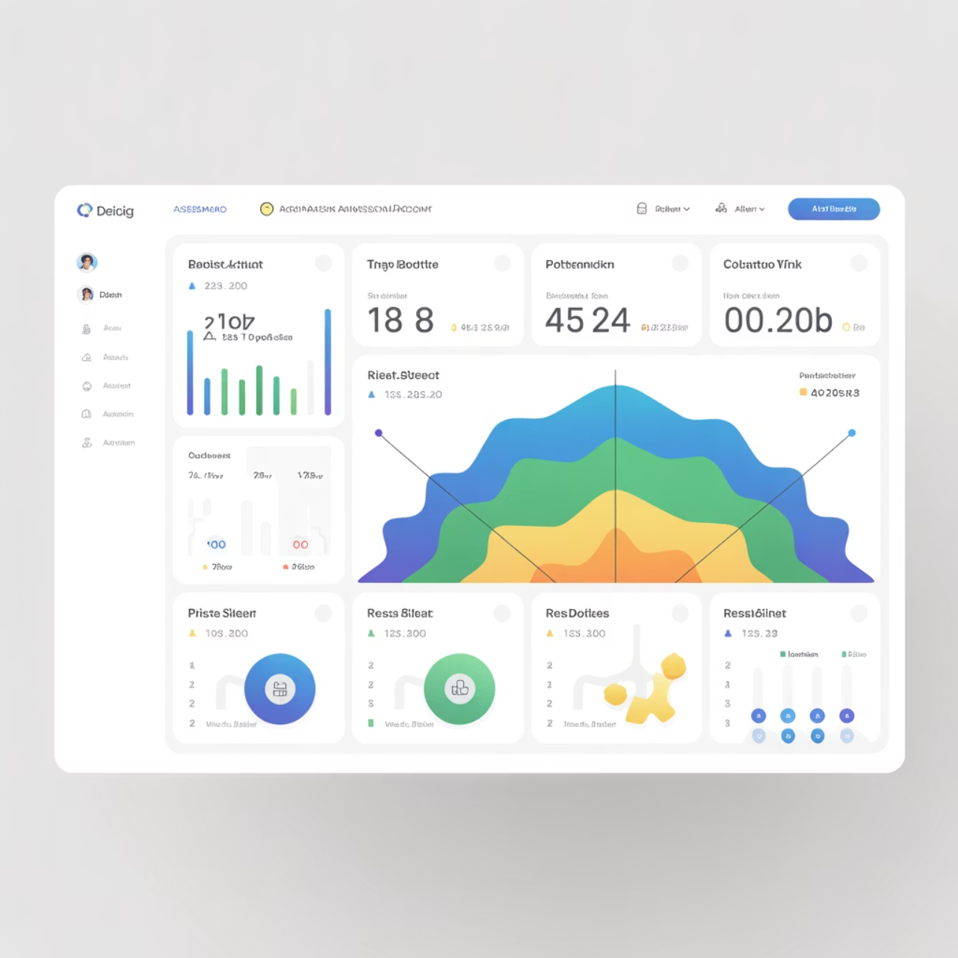
Evaluating Risk Exposure
Risk exposure evaluates potential impact and likelihood of threats, guiding resilience investments and strategic responses.
Risk Exposure Components
Threat Probability: Likelihood of risks occurring
Impact Magnitude: Financial, operational, and reputational consequences
Vulnerability Assessment: Weaknesses increasing threat susceptibility
Threat Categories: Physical, cyber, and vendor risks
This evaluation links threat assessments to business risk tolerance, ensuring resilience strategies align with organizational risk appetite and executive expectations.

Slide 22

Cost/Benefit Perspective
Strategic resilience investment balances protection costs against the value of business continuity, ensuring measurable ROI and alignment with organizational objectives.
Cost Categories
Direct Costs: Technology, infrastructure, personnel
Indirect Costs: Opportunity costs, ongoing maintenance
Hidden Costs: Reputation damage, regulatory penalties
Benefit Evaluation
Avoided Losses: Prevented revenue loss, reduced downtime
Competitive Advantage: Faster recovery, enhanced reputation
Operational Benefits: Improved processes, risk reduction
This analysis encourages proportional, sustainable resilience investment that aligns with organizational maturity, resources, and long-term objectives.

Slide 23

Resource Availability and Constraints
Implementing a resilience strategy demands a realistic assessment of organizational capacity. Resource constraints heavily influence feasibility and sustainability.
Key Resource Categories
Human: Skilled personnel, expertise, training
Financial: Capital, operational funding, ROI
Technical: Infrastructure, systems, vendor relationships
Organizational: Change management, culture, leadership
For resource-limited organizations, a phased implementation approach builds capabilities incrementally. This ensures sustainable resilience development, managing costs and complexity over time.

Slide 24
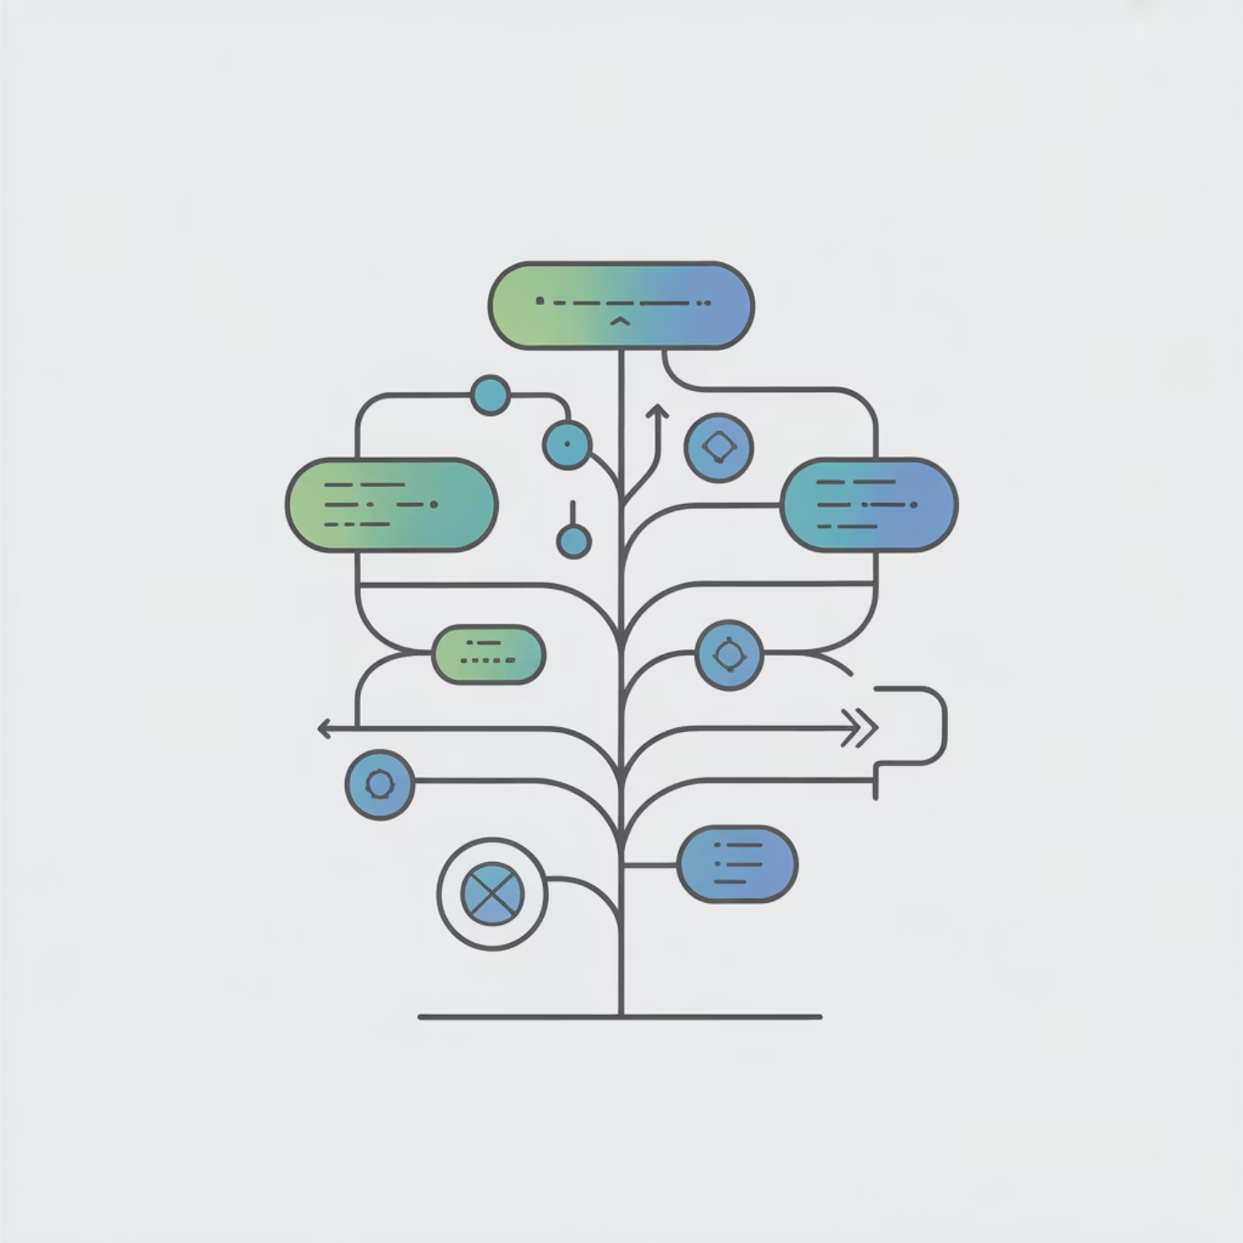
Decision Frameworks for Strategy Selection
Structured frameworks provide consistent evaluation criteria for resilience strategy. They ensure decisions are traceable, repeatable, and aligned with industry best practices and certification requirements.
Key Framework Standards
ISO 22301: International standard for Business Continuity Management Systems.
NIST SP 800-34: Contingency planning guide for strategy selection and implementation.
DRI Professional Practices: Industry-recognized practices for certification.
Organizational Standards: Internal frameworks adapted to specific business contexts.
DRI certifications emphasize structured assessment, integrating cybersecurity and business continuity for robust resilience program management.

Slide 25

Integrating BIA Results into Strategy Decisions
BIA results form the core foundation for strategic resilience decisions, guiding investment and prioritization based on organizational functions.
Key BIA Integration Elements
Recovery Time Objectives (RTO): Maximum acceptable downtime drives recovery urgency.
Recovery Point Objectives (RPO): Data loss tolerance shapes backup and replication strategies.
Recovery Sequence: Process dependencies guide restoration priorities.
Impact Thresholds: Financial and operational impact justify protection investments.
Dependency Mapping: Critical relationships inform strategy scope.
BIA provides a quantitative basis for strategy selection, linking business needs to resilience capabilities and ensuring investments align with risk management and continuity priorities.

Slide 26

Scenario-Based Evaluation
Scenario-based evaluation tests strategy performance using realistic threat situations, identifying weaknesses and improving resilience approaches.
Strategy Validation: Confirms effectiveness under realistic threats.
Weakness Identification: Reveals vulnerabilities and misaligned responses.
Resource Verification: Tests sufficiency of allocated resources.
Integration Testing: Evaluates coordination across functions.
Adaptability Assessment: Measures flexibility in varying incident conditions.

Slide 27

Balancing Risk and Cost
Effective resilience strategies balance risk reduction with cost-effectiveness, aiming for optimal business impact reduction while maintaining organizational sustainability.
Risk-Cost Balance Principles
Proportional Investment: Align protection levels with potential business impact, not just theoretical risk.
Risk Tiering: Apply varied protection based on impact severity and likelihood combinations.
Cost Optimization: Find efficient solutions that maximize protection per investment.
Acceptable Risk: Acknowledge risks that may be accepted after a cost-benefit analysis.
Dynamic Adjustment: Periodically reassess the balance as threat landscapes and business conditions evolve.

Slide 28
Tiered Strategy Options
Tiered resilience strategies allocate resources based on process criticality and business impact, aligning with DRI Professional Practices for efficient prioritization.
Strategy Tier Framework
Tier 1: Mission-Critical
Tier 2: High-Impact
Tier 3: Supportive
Continuous operations
Rapid recovery to minimize disruption
Restored after higher-priority systems
Highest investment: redundancy & recovery
Moderate investment in recovery
Basic, cost-effective recovery
Immediate restoration, minimal downtime
Defined RTO with brief interruptions
Extended RTO with manual workarounds
Comprehensive testing
Regular testing & procedures
Simplified testing

Slide 29

Collaboration in Strategy Development
Effective resilience strategies require cross-functional integration. Collaboration ensures practical, comprehensive, and sustainable outcomes by fostering shared ownership.
Key Stakeholder Involvement
Executive Leadership: Strategic direction, resource allocation, and governance.
Human Resources: Workforce planning, training, and personnel management.
Information Technology: Technical infrastructure and recovery capabilities.
Communications: Internal/external messaging and crisis communication.
Operations: Process knowledge and practical implementation.
Shared ownership and robust governance are vital for sustainable resilience, ensuring accountability and alignment with organizational objectives.
Finance: Cost analysis, budget planning, and ROI evaluation.

Slide 30

Common Pitfalls in Strategy Selection
Recognizing common pitfalls helps organizations avoid costly errors and develop more effective resilience strategies.
Ignoring Cost-Benefit: Pursuing maximum protection without proportional investment.
Lack of Leadership Engagement: Proceeding without adequate executive support.
Underestimating Human Factors: Overlooking change management and organizational readiness.
Insufficient Testing: Assuming strategies will work without proper validation.
Neglecting Maintenance: Failing to plan for ongoing updates and capability maintenance.
Avoiding these pitfalls requires structured planning, realistic assessment, and a commitment to continuous improvement.

Slide 31

Summary and Key Takeaways
Strategic Balance: Balance risk, criticality, cost, and organizational capabilities.
Framework-Driven Decisions: Utilize ISO 22301, NIST SP 800-34, and DRI Professional Practices for robust strategy.
Prioritization by Criticality: Business Impact Analysis and risk assessment findings guide resource allocation.
Tiered Investment: Implement differentiated strategies across mission-critical, high-impact, and supportive tiers.
Cross-Functional Collaboration: Ensure alignment with leadership, operations, IT, HR, and finance perspectives.
Continuous Improvement: Regularly review, test, and adapt strategies to evolving threats and changes.
Remember: Sustainable resilience means strategic, right-sized investments that deliver measurable business value and maintain operational effectiveness during crises.

Slide 32
BREAK TIME
Be back in 15 mins.
Notes:
https://www.ncsc.gov.uk/static-assets/documents/PwnedPasswordsTop100k.txt

Slide 33

Tiered Strategy Development
Resilience Strategic Overview & Frameworks
This session explains how to structure resilience strategies using a tiered approach. Learners will understand how to group functions, processes, and recovery strategies into priority tiers based on organizational impact and criticality, enabling more effective resource allocation and recovery planning.
Key Learning Areas
What is a tiered approach and its strategic value
Benefits of structured prioritization in resilience planning
Connection to BIA findings and continuity objectives
Preparation for DRI International certifications (ABCP, CBCP, ACRP, CCRP)

Slide 34
Agenda and Learning Objectives
Agenda
Learning Objectives
Purpose and value of tiered strategies
Identify appropriate tier levels and their rationale
Defining tier levels and classification criteria
Apply tiering methodology to business processes
Linking tiers to business impact priorities
Connect tier classifications to RTO/RPO requirements
Resource allocation and recovery time alignment
Align tiered strategies with DRI domains and frameworks
Implementation and communication strategies
Develop clear communication plans for tier implementation
Note: This module directly supports preparation for DRI International certification examinations and aligns with business continuity management professional practices.

Slide 35

What Are Tiered Strategies?
Tiered strategies represent structured groupings of recovery priorities that organize business functions, processes, and systems based on their criticality to organizational survival and success. Each tier corresponds to defined recovery objectives based on impact severity and acceptable downtime tolerances.
Core Principles:
Systematic categorization based on business impact analysis
Clear recovery time and point objectives for each tier
Scalable resource allocation aligned with criticality
Simplified decision-making during crisis situations
This approach supports scalability, provides operational clarity, and enables efficient resource utilization during both planning and incident response phases.

Slide 36
Benefits of a Tiered Approach
Implementing tiered strategies provides multiple organizational advantages that enhance resilience maturity and operational effectiveness.
Crisis Simplification
Phased Recovery
Eliminates confusion during incidents by providing clear prioritization guidelines for recovery teams and leadership decision-making.
Enables systematic restoration approaches and facilitates clear communication to stakeholders about recovery progress and expectations.
Alignment Achievement
Transparency Provision
Unifies operational and technical planning efforts, ensuring IT recovery supports business priorities rather than operating independently.
Provides clear framework for leadership oversight and regulatory/audit compliance, demonstrating structured approach to risk management.

Slide 37

Tier 1: Mission-Critical Operations
Tier 1 encompasses functions and systems that must continue operating under all circumstances. These represent the absolute core of organizational survival and customer service delivery capabilities.
Defining Characteristics:
Zero tolerance for extended outages
Immediate impact on customer service or safety
Shortest possible RTO requirements (minutes to hours)
Strongest resilience controls and redundancy
Highest investment in protective measures
Common Examples:
Banking transaction processing systems
Emergency response communication networks

Slide 38

Tier 2: High-Impact but Recoverable Functions
Tier 2 includes functions that can pause briefly but require quick restoration to prevent significant business impact. These processes support critical operations but have some tolerance for temporary disruption.
Key Characteristics:
Moderate tolerance for brief outages (hours to days)
Temporary disruption causes operational challenges but not failure
Recovery depends on partial redundancy or documented workarounds
Significant but manageable business impact during downtime
Balanced investment in recovery capabilities
Typical Examples:
Human resources management systems
Business analytics and reporting platforms
Supply chain and logistics coordination
Financial planning and accounting systems
Customer relationship management tools

Slide 39

Tier 3: Support and Non-Essential Processes
Tier 3 encompasses functions that can tolerate extended outages with minimal business risk. These processes support organizational efficiency but are not critical for immediate survival or delivery.
Defining Features:
Extended tolerance for outages (days to weeks)
Minimal immediate impact on customer service
Focus on cost-effective recovery and strategic deferral
Lower priority in resource allocation during incidents
Emphasis on efficient restoration over rapid recovery
Representative Examples:
Marketing campaign management dashboards
Internal reporting and compliance systems
Training and development platforms

Slide 40

Linking Tiers to BIA and Risk Assessment
Tiered strategy development must be directly connected to business impact analysis (BIA) findings and organizational risk assessment results to ensure alignment with actual business needs and risk tolerance.
Integration Process:
BIA Determines Classification: Maximum tolerable downtime and impact severity data from BIA directly determines which tier each activity belongs to
RTO/RPO Guide Tiers: Recovery time objectives and recovery point objectives established during BIA inform tier-specific recovery requirements
Dependency Mapping: Interdependency analysis ensures supporting systems are classified appropriately relative to dependent critical functions
Risk Tolerance Alignment: Organizational risk appetite and regulatory requirements influence acceptable tier definitions and recovery standards
This linkage ensures that tiered strategies reflect actual business priorities rather than IT convenience or assumptions about criticality.

Slide 41
Implementing and Communicating Tiers
Successful tiered strategy implementation requires systematic documentation, comprehensive training, and ongoing validation to ensure organizational understanding and capability.
Implementation Framework:
Clear Documentation: Document tier criteria, classification rationale, and recovery expectations in formal resilience plans and procedures
Department Training: Educate all departments on their tier classifications, recovery expectations, and specific roles during incidents
Leadership Alignment: Ensure executive understanding and support for tier-based resource allocation and recovery sequencing decisions
Validation Through Testing: Conduct regular exercises that validate tier assumptions and test recovery capabilities at each level
Communication Best Practices:
Use clear, non-technical language for business stakeholders
Provide specific examples relevant to each department
Regularly review and update classifications as business changes
Create visual representations of tier relationships and dependencies

Slide 42

Summary and Key Takeaways
Strategic Value: Tiered strategies ensure organizational effort and investment match actual business criticality, preventing both over-investment in low-priority areas and under-protection of critical functions.
Hierarchy of Protection: Higher tiers demand stronger resilience measures, faster recovery capabilities, and greater resource allocation, creating a logical framework for risk management decisions.
Integration Imperative: Effective tiers seamlessly connect business impact analysis findings, recovery time objectives, and risk management frameworks into a unified approach.
Communication Foundation: Clear documentation and validation through testing sustain organizational maturity and ensure tier classifications remain relevant as business requirements evolve.
Certification Alignment: These concepts directly support DRI International certification preparation and demonstrate professional competency in resilience strategy development.

Slide 43
BREAK TIME
Be back in 15 mins.
Notes:
https://www.ncsc.gov.uk/static-assets/documents/PwnedPasswordsTop100k.txt

Slide 44

Regulatory and Compliance Drivers
This session explores how international and industry-specific regulations such as ISO 27001 and FFIEC shape resilience strategy. Learners will understand compliance obligations, governance expectations, and their alignment with resilience maturity frameworks for effective business continuity programs.
Learning Objectives
Identify major regulatory influences on resilience
Explain the role of ISO 27001 and FFIEC in continuity strategy
Connect compliance requirements to organizational maturity models
Prepare for DRI International certification examinations

Slide 45
CLASS AGENDA
CLASS OBJECTIVES
Overview of resilience-related regulations
ISO 27001 information security management and business continuity
FFIEC financial sector continuity requirements
Integration with established continuity frameworks
Compliance reporting, auditing, and governance expectations
Identify major regulatory influences on resilience planning and implementation
Explain the specific role of ISO 27001 and FFIEC in shaping strategy design
Connect regulatory compliance to organizational maturity and readiness
Understand governance structures that support regulatory alignment

Slide 46

Why Regulations Drive Resilience
Regulations ensure organizations safeguard critical operations by establishing minimum standards for availability, data protection, and risk management. They create accountability frameworks that protect stakeholders, customers, and the broader economic ecosystem.
Compliance strengthens governance structures and builds customer confidence through demonstrated preparedness and operational reliability. Organizations subject to regulatory oversight must prove their resilience capabilities through documentation, testing, and continuous improvement processes.
Regulatory frameworks provide structured approaches to risk management, ensuring organizations consider both internal vulnerabilities and external threats in their continuity planning.

Slide 47
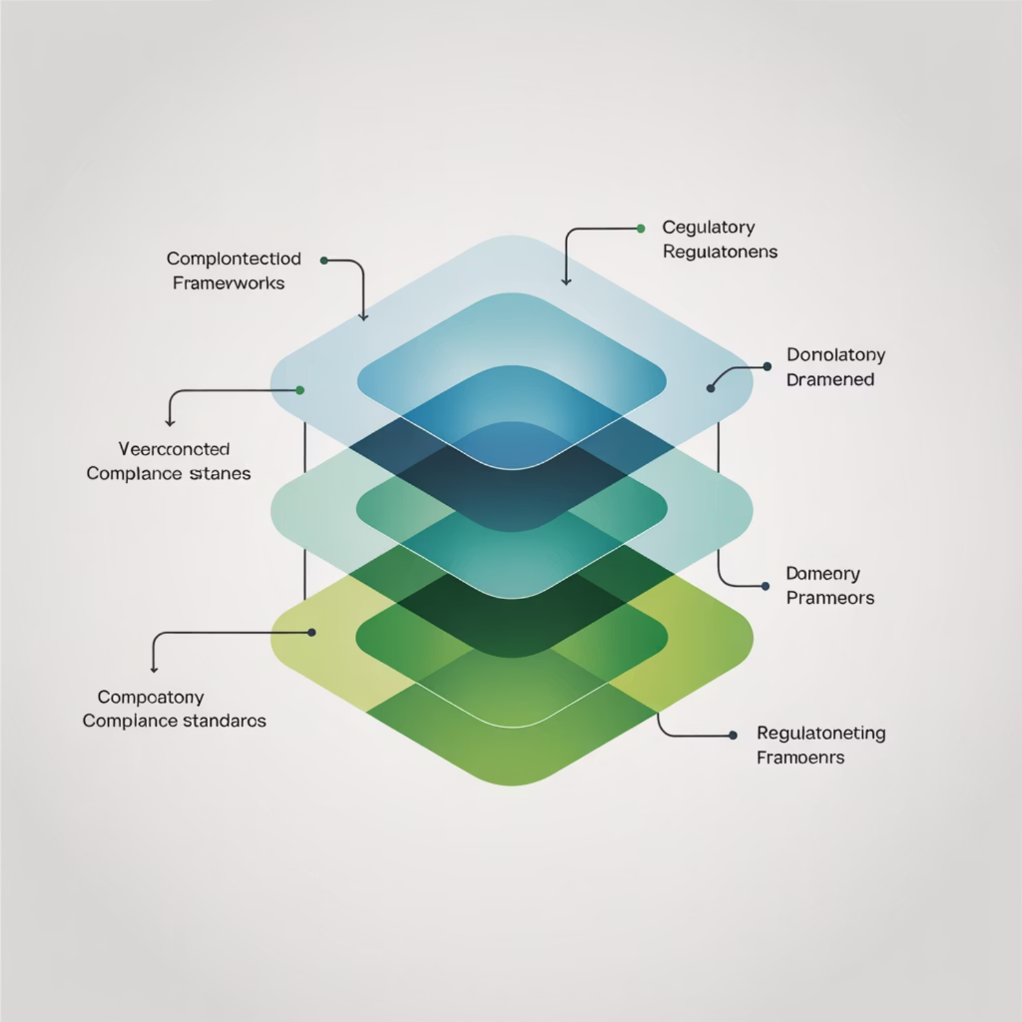
Overview of Key Frameworks
Resilience and business continuity intersect with multiple regulatory standards and legal requirements across industries and jurisdictions. Understanding these interconnections is essential for comprehensive compliance strategies.
Common global regulatory drivers include:
ISO 27001: Information Security Management Systems with integrated business continuity requirements
FFIEC: Financial institutions' continuity, cybersecurity, and operational resilience standards
NIST SP 800-34: Federal guidance for information system contingency planning
SOC 2: Service organization controls addressing availability and security
These frameworks often complement and reinforce each other, requiring coordinated implementation approaches.

Slide 48

ISO 27001: Information Security and Resilience
ISO 27001 focuses on protecting information confidentiality, integrity, and availability (CIA triad) through comprehensive management system requirements. Annex A.17 specifically requires organizations to integrate information security continuity measures into their business continuity management systems.
Organizations must establish, document, implement and maintain processes, procedures and controls to ensure required levels of information security continuity during disruptive situations. The framework builds upon industry best practices and aligns with ISO 22301 Business Continuity Management standards.
ISO 27001 certification demonstrates organizational commitment to compliance and operational readiness, providing third-party validation of security and continuity capabilities.

Slide 49

FFIEC: Financial Sector Expectations
FFIEC guidelines are widely regarded as the gold standard of business continuity management, with more stringent governance, risk assessment, business impact analysis, planning, testing, and maintenance requirements than any other standard.
Core regulatory focus areas include:
Business continuity management governance and resilience strategies to safeguard employees, customers, and critical financial services
Information security, cybersecurity frameworks, and operational resilience programs
Third-party service provider risk management and alternative contingency planning
FFIEC requires comprehensive testing, detailed documentation, executive accountability, and regular board-level reporting on business continuity readiness.

Slide 50

Common Elements Across Regulations
Despite different origins and specific requirements, major regulatory frameworks share fundamental principles that support comprehensive resilience strategies.
Shared regulatory principles include:
Risk assessment methodologies and documented business impact analysis processes
Clear recovery time objectives (RTO) and recovery point objectives (RPO) with acceptable downtime and data loss parameters
These common elements align directly with DRI Professional Practices, creating natural integration opportunities for comprehensive compliance approaches.
Regular testing, evaluation, and continuous improvement of continuity controls and procedures
Governance structures, executive accountability, and board-level oversight requirements

Slide 51

Integrating Compliance into Strategy
Compliance should guide rather than limit resilience efforts, requiring cultural alignment beyond simple documentation exercises. Successful integration embeds regulatory goals into operational planning processes and daily business decisions.
Strategic integration approaches:
Map organizational resilience controls directly to specific regulatory framework requirements
Implement regulatory standards as integrated sub-projects within broader resilience programs
Treat multiple compliance requirements as unified business continuity planning efforts
Establish cross-functional teams with shared accountability for compliance and operational resilience
Example: ISO 27001 Annex A controls can be directly mapped to business continuity policy frameworks, creating efficiency in both compliance demonstration and operational preparedness.

Slide 52

Challenges in Maintaining Compliance
Organizations face significant operational challenges when managing multiple regulatory requirements simultaneously, requiring strategic approaches to avoid compliance fatigue and resource conflicts.
Common compliance challenges include:
Overlap between multiple frameworks that can create misaligned priorities or incomplete testing coverage
Documentation fatigue and audit readiness pressures that shift focus from operational effectiveness to procedural compliance
Resource constraints when trying to satisfy multiple regulatory examiner expectations simultaneously
Regular internal audits, after-action reports, and systematic improvement processes help identify gaps and maintain alignment with evolving regulatory requirements.
Continuous alignment requirements as regulations evolve and organizational operations change

Slide 53

Summary and Key Takeaways
Regulatory Foundation: Regulations like ISO 27001 and FFIEC provide structured frameworks that shape organizational resilience maturity and executive accountability for critical operations.
Comprehensive Standards: FFIEC represents the most comprehensive business continuity standard, covering all BCM lifecycle phases with robust governance and testing requirements.
Strategic Integration: Successful compliance builds organizational credibility and stakeholder trust through integrated approaches that embed regulatory requirements into operational planning.
Continuous Improvement: Ongoing assessment, testing, and improvement processes ensure sustainable compliance while maintaining operational resilience and readiness.
Professional Development: Understanding these regulatory drivers prepares practitioners for DRI International certifications and enhances career readiness in resilience and business continuity management.

Slide 54
Lab Time
1 Hour
Notes:
https://www.ncsc.gov.uk/static-assets/documents/PwnedPasswordsTop100k.txt

Slide 55
Kahootz & Quiz Time
Notes:
https://www.ncsc.gov.uk/static-assets/documents/PwnedPasswordsTop100k.txt

